Slide 1
A Legitimate Democracy
By william hayes

Slide 2
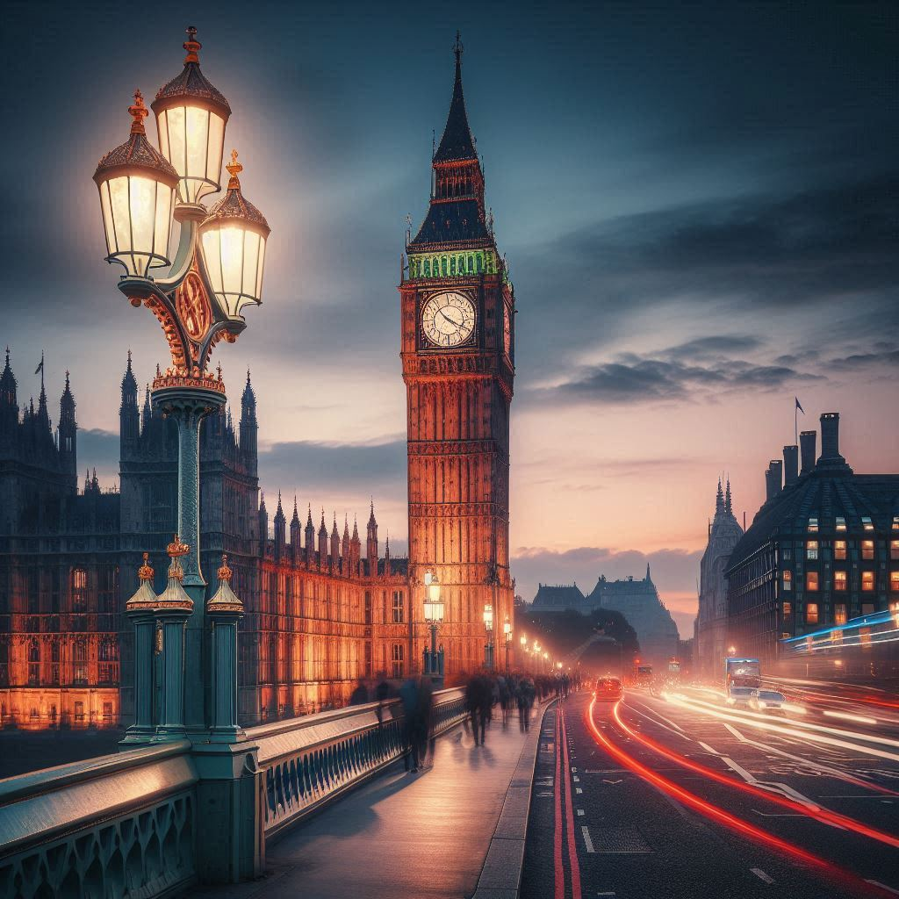
England Dream

Slide 3
Introduction
Mobile Phones please to silent
Opportunity for questions during and after
Will take approximately
Myself my name is Liam Hayes

Slide 4
Great Power Thinking and Strategic
Positioning of England in the Post-Empire
A peaceful Revolution in our Time, where Every Citizen Matters
The Young are The Future
Leadership at its Very Best

Slide 5
The opportunity arises in our time to live the English Dream and create a Legitimate Democracy
One where England is strong and central in Local, National and International affairs
Society needs to undertake the biggest reality check in generations, allowing the legitimate majority to prevail and for all English Citizens to count and make their views matter

Slide 6
A strong, sustainable, stable, modern, mature, fair, fit, for purpose and fundamentally, a true legitimate democracy, whose foundations would preserve the very best of our rich History
Future generations must be brave, bold and not be shackled or Imprisoned by the past
Twenty-year plan applying reform within the first two years of local and national political system, based on
the ten foundations for a legitimate English Nation-State

Slide 7
A resilient creative society, which attracts, cultivates, absorbs innovation and talent
"Culture is not a substitute for life, but the key to it"

Slide 8
Supporting centuries of hard-won liberty and freedom, society moving forward to a future with majority participation, where political representatives promote the views of the electorate and put the English Nation-State and its people before vested party or other interests
This to empower English Citizen's through participation by right and obligation

Slide 9
A nation that works to cease and limit the blame and fear culture that has eroded trust, belief and the ability of many to succeed
Leaving behind the decades of ever-increasing abuse of power, corruption, greed in political, public and private sector, and businesses

Slide 10
Fundamental political reforms required;
The transformation and decentralisation of the public sector, civil service and related organisational structures and management
This should be done within the first two years of the twenty-year plan
Foundations and aims covering the future leadership and management within the public sector

Slide 11
The right of voting citizenship at 16, in line with the right to be employed, obligation to pay NI and tax on PAYE
The right to marry and to have consensual sex, join the armed forces, to drive, to have ownership

Slide 12
Voting
A legal obligation for all citizens where all votes count proportionately
Those who don't like to vote or support any of the candidates or manifestos
Can demonstrate their objection, on a ballot paper, ticking "None of The Above"

Slide 13
All Citizens, continue to be involved and make their views matter
Right to peaceful demonstration and free speech to be enshrined in legislation
Stand down the career minority elected Politician's, with too little to do, who interfere far too often
Removing the first past the post system

Slide 14
Creating an English Nation that's vibrant, tolerant, within an alliance of neighbouring nation states
Forming an Alliance of mutual support for agreed, Defence, Security, Monetary and Economic Union
Freedom of trade, labour movement and right to benefits subject to English-Nation Statehood legislation

Slide 15
Strong, cohesive society with support for a diverse and inclusive culture
"Hope springs eternal, whilst despair is a dry well"

Slide 16
THE 10 FOUNDATIONS FOR A LEGITIMATE DEMOCRACY
An English Parliament (EP)
An English Senate (ES)
Devolved Government (and related Institutions to District Assembly's) (DA)
Compulsory Voting (CV)

Slide 17
THE 10 FOUNDATIONS FOR A LEGITIMATE DEMOCRACY
Proportional Representation (PR)
English Citizenship (and National Identification)
A Secular English State
Voting age at 16

Slide 18
THE 10 FOUNDATIONS FOR A LEGITIMATE DEMOCRACY
Reformed UK and European Unions
Compulsory Education
--Training and Occupation up to 21 years of Age

Slide 19
The English Nation-State.
-- The English Parliament (EP)
An inspirational, creative, patriotic English Nation-State, which has an elected representative parliament every 5 years, committed to, long term stability and reform
With annual plans agreed within the overall 20 year plan

Slide 20
The English Nation-State.
-- The English Senate (ES)
An elected legislative and constitutional chamber, based on a senate model, with a Senate Member (SM) elected for a 7-year term with a maximum 14 year's every 28 years
The English Senate (ES) should oversee legislative and constitutional matters

Slide 21
The English Nation-State.
-- The District Assembly (DA)
Districts would have an elected Assembly, of one Assembly Member (AM) per 10,000 population
The newly elected District Assembly (DA) will oversee the smooth peaceful abolition of parish councils within an agreed legislative and constitutional framework, the latter being approved by the EP and ES

Slide 22
The English Nation-State.
-- The District Assembly (DA)
With County councils, Regional political organisations and other levels abolished

Slide 23
The English Nation-State.
-- The Compulsory Voting (CV)
English Citizens will be registered to vote automatically from birth, and be required to vote in State, Senate and District Assembly elections, on reaching the age of consent at 16 years old
An age when young people could leave home and education, have consensual sex, enter partnerships and have children, learn to drive, become employed, join the armed forces, obtain a passport, work and contribute to PAYE and NI

Slide 24
The English Nation-State.
-- Proportional Representation (PR)
The first past the post system and minority party control will be abolished and replaced with the proportional representation system
This will be enshrined in the English Constitution and underpinned by statute and legislation

Slide 25
The English Nation-State.
-- English Citizenship and National Identity
Registered at birth and given a unique National Insurance Number and National Secure Identity Card On reaching 16 this will become a photo ID card
Other ID schemes will be integrated with the ID number
Passport Already In force

Slide 26
The English Nation-State.
-- English Citizenship and National Identity
Parents / guardians will be responsible for children's ID cards until the age of 16. English passports will be issued on the same basis as national ID, for foreign travel outside any neighbouring Unions requiring them or visa's etc.

Slide 27
The English Nation-State.
-- Secular English State
The roles of unelected Royalty and Religion should be removed from statute, legislation and a new English Constitution
Current and future Royal and Religious roles should be focused on independent charitable activities, which are related to ceremonial duties, of National and local historical and public significance

Slide 28
The English Nation-State.
-- Secular English State
Royalty and Religion should provide the Nation with significant added value.
Using their knowledge, influence, expertise, income and assets for the public good to promote, protect and develop the following:
10 Primary Roles;

Slide 29
10 Primary Roles;
Peaceful, spiritual doctrine
Sanctuary, Haven, Asylum and Retreat
Heritage
Tourism
Charity​​​
Education
Environment​​​
Employment​​​​​​
Ceremonial​
Citizen Awards and Honours

Slide 30
The English Nation-State.
-- Voting Age 16
"Give them roots then let them fly"
Young people are the future and should be fully recognised, respected and engaged
Full responsibility and commitment to education, development of themselves, others and the state, they should receive a grant equal to 50% of the National minimum wage between the age of 16 and 21, where needed

Slide 31
The English Nation-State.
-- Reformed United Kingdom (UK) and European Union's (EU)
The current UK union should facilitate and support devolved nation states in Northern Ireland, Wales and Scotland
This should be subject to a referendum based on Compulsory Voting (CV) and Proportional Representation (PR)

Slide 32
The English Nation-State.
-- Compulsory Right to Education,
Training and Occupation to Age 21
"People with roots, have a foundation to build on"
Compulsory right to Education, Training and Occupation within the Public, Charitable, Voluntary and Private sectors for all Citizens aged 16 -- 21, this being both a right and obligation, which should apply to all people of all abilities

Slide 33
"Ability,
is the power of applying knowledge to practical purposes"

